Slide 1
Table of Variation
Image Processing

Slide 2
Image formats
PNG, JPEG, GIF, HEIC, TIFF, DPX, EXR, WebP, Postscript, PDF, and SVG
«raster image formats»: PNG, JPEG, BMP, TIFF
JPG (=Joint Photographic Experts Group)
PNG (=Portable Network Graphics)
de facto standard image of the internet
lossy nature
loss can accumulate: degradation with every save
Solution: lossless JPG2000
Small file size
compress image to blocks of pixels or “tiles”
permanent compression
for storing large photographic image files in surprisingly small spaces
JPGs support 24-bit RGB and CMYK, as well as 8-bit Grayscale
supports transparency in browsers
non-lossy nature
ideal for screenshot software
Biggest file size of all image formats (24-bit PNG is larger than 8-bit PNG)

Slide 3
Save formats
.csv | .json | .txt | .pkl

Slide 4
Pixel
Get better resolution by increasing dpi (=dots per inch) vs ppi (=pixels per inch)
300 dpi = high resolution photo

Slide 5
Scale spaces
RGB | HSV | CIE*Lab | HSB | HEX | CMYK
 | 8-bit image: (integer, less precision) 0-180, 0-255, 0-250 32-bit image: (floats, for higher precision) 0-360, 0-100, 0-100

Slide 6
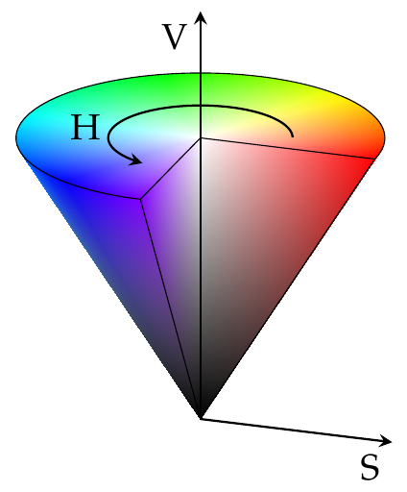
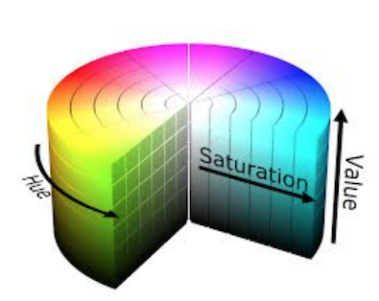
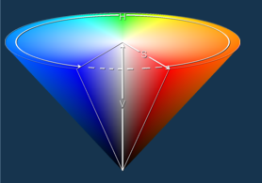
Color spaces
RGB | HSV | CIE*Lab | HSB | HEX | CMYK
domain | Hue, Saturation, and Value (or brightness) | L* axis (lightness) ranges from 0 to 100 a* and b* (color attributes) axis range from -128 to +127
 | cylindrical
 | hues, are modeled as an angular dimension rotating around a central, vertical axis, which represents the value channel. Values go from dark (0 at the bottom) to light at the top. The third axis, saturation, defines the shades of hue from least saturated, at the vertical axis, to most saturated furthest away from the center
 | The Hue/Saturation/Value model was created by A. R. Smith in 1978. It is based on such intuitive color characteristics as tint, shade and tone (or family, purety and intensity). The coordinate system is cylindrical, and the colors are defined inside a hexcone. The hue value H runs from 0 to 360º. The saturation S is the degree of strength or purity and is from 0 to 1. Purity is how much white is added to the color, so S=1 makes the purest color (no white). Brightness V also ranges from 0 to 1, where 0 is the black.

Slide 7
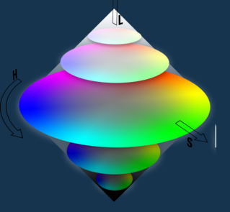
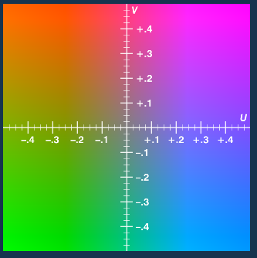
Color spaces
CMY | CIE XYZ | CIE Yxy | CIELCh | HSL | YUV

Slide 8
Palette Interpolation
Neural Network | Latent Dirichlet allocation | Gaussian process laten variable models (GPLVM) + optimizer = ‘SCG’ + kernel = ‘RBF’ + no_latent_dim=4 | PCA (dimRed)+ GMM (density est.)
 |  | Done in paper (Phan et al.)
 |  | + Can deal with small data sets | - Less diverse results
 |  | + non-linear dimRed mapping from latent space to observed space (minimization of negative log-likelihood wrt kernel params and latent points) | - Less accurate in predicting colors
 |  | Shares objective function with other dimReds: KPCA, Prob. PCA, MDS
 |  | Manifold learning: find embedded non-linear topological manifold in high-dim space by invers projection of low-dim back to original space
 |  | Computes density because assigns likelihoods of data points in latent space

Slide 9
Image Classification
CNN | Mask
 | If 2 areas are not connected, they are separate, but …

Slide 10
Bijective
injective

Slide 11
Kombinatorik
Variation order matters repetition allowed n^r
Permutation order matters repetition not allowed P(n,r) = n! / (n-r)!
Combination order does not matter repetition allowed C(n,r) = n!/ r! (n-r)!
Combination order does not matter repetition not allowed C(n,r) = (n+r-1)!/ r! (n-1)!

Slide 12
Pairwise: Combination, Permutation, Cartesian product
Permutation
Combination
Cartesian Product
 | Cat | Dog | Rabbit
Cat | 1 | 2 | 0
Dog | 2 | 1 | 2
Rabbit | 0 | 2 | 1
 | Cat | Dog | Rabbit
Cat | 1 | 2 | 0
Dog | 2 | 1 | 2
Rabbit | 0 | 2 | 1
 | Cat | Dog | Rabbit
Cat | 1 | 2 | 0
Dog | 2 | 1 | 2
Rabbit | 0 | 2 | 1
import itertools
x = [1, 2, 3]
[p for p in itertools.product(x, repeat=2)]
[(1, 1), (1, 2), (1, 3),
(2, 1), (2, 2), (2, 3),
(3, 1), (3, 2), (3, 3)]
import itertools
x = [1, 2, 3]
list(itertools.permutations(x, 2))
[(1, 2), (1, 3), (1, 4), (2, 1), (2, 3), (2, 4), (3, 1), (3, 2), (3, 4), (4, 1), (4, 2), (4, 3)]
import itertools
x = [1, 2, 3]
list(itertools.combinations(x, 2))
[(1, 2), (1, 3),
(2, 3)]

Slide 14

Libraries
openCV
Slic
seed
Scikit-image
bokeh

